Slide 1
Designing an End-to-End Offline Evaluation Pipeline
Jin Young Kim, Microsoft
jink@microsoft.com

Slide 2

Speaker Bio
Graduated from UMass Amherst with Ph.D in 2012
Spent past 4 years in Bing’s Relevance Measurement / Science Team
Taught MSFT course on offline evaluation
Passionate for working with data of all kinds (search, personal, baseball, …)

Slide 3
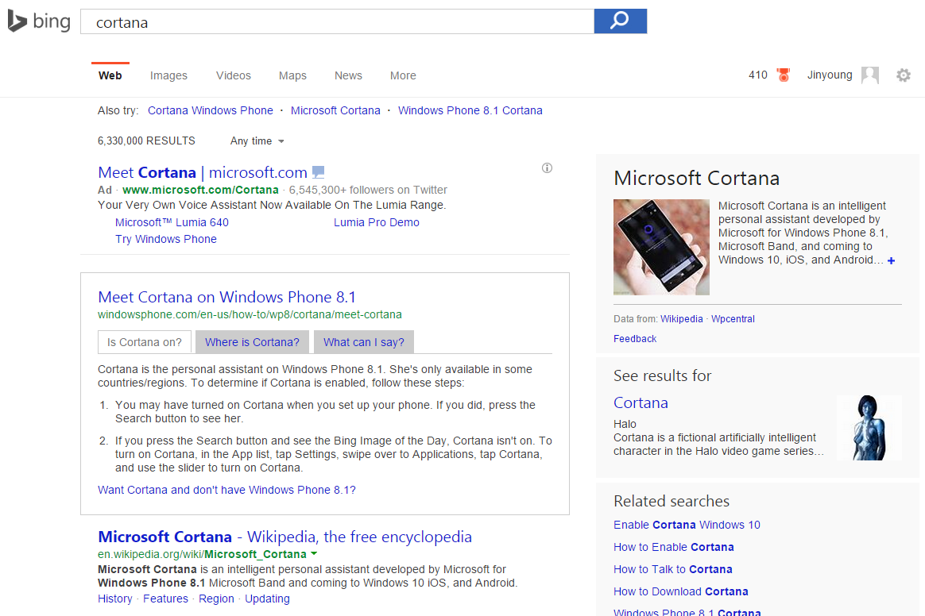
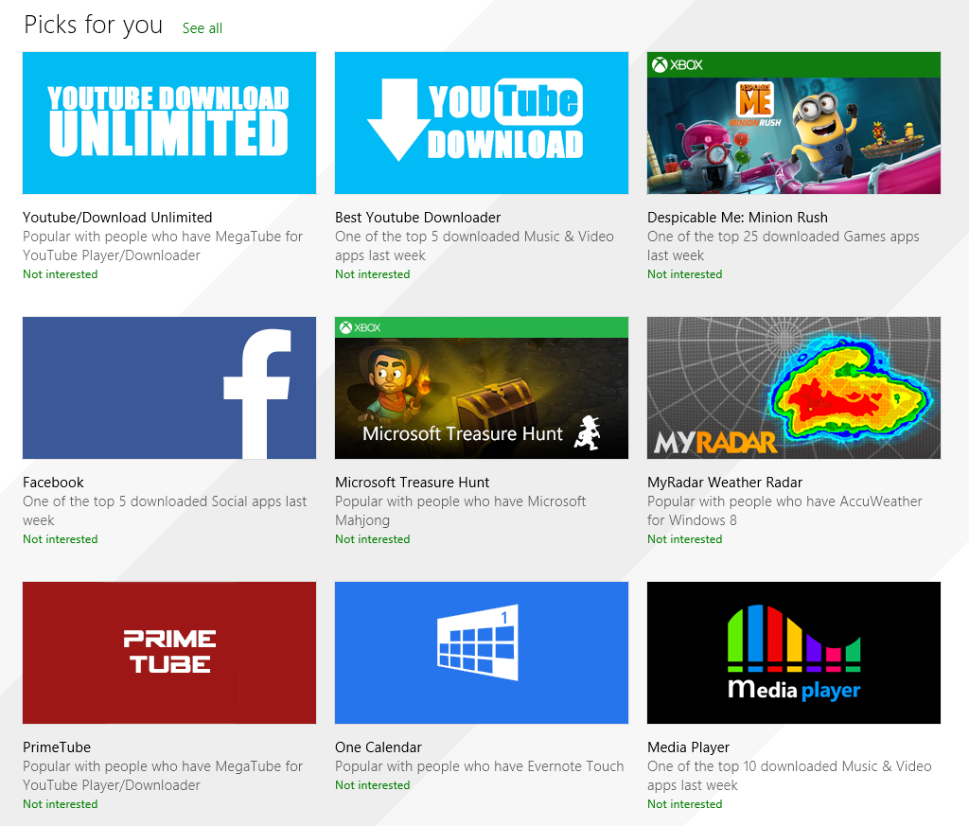
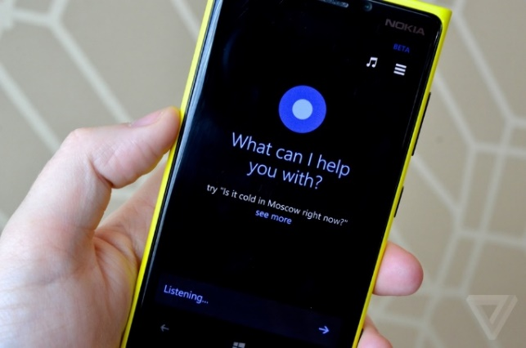
Evaluating a Data Product
How would you evaluate Web Search, App Recommendations, and even an Intelligent Agent?
Notes:
Different from software evaluation:
Output depends on task & user / Subjective quality

Slide 4

Better Evaluation = Better Data Product
Investment decisions
Which area / feature to invest in?
Shipping decisions
Track goal / progress
More effective ML models
Which version should we ship?
How far are we from FY2015 goal?
How to get training data for ML model?
Notes:
Evaluation is critical in every stages of development
Harry Shum: ‘We are as good as having the perfect WSE if we perfect the evaluation’

Slide 5
Wait, can’t we just use online user data?
Behavior tells only a half of the story : need for labels
User behavior is subject to various bias : need for controlled env.
User data is not an option in early stages : need for bootstrapping
Team
Human Judges
Users
Enable early iteration
Represent user voice
Operationalize policy

Slide 6
Pros and cons of oﬄine vs. online evaluation
 | Online | Offline
Pros | Very little marginal cost Based on actual user behavior | No need for production system Easy to try new ideas Amortized Cost / Reusability
Cons | Need for production system Need for large-scale data Noisy interpretation of behavior | High marginal cost of label collection Need for judging infrastructure Need for ‘ground truth’ judgments Difficult to model real users’ behavior

Slide 7
Tutorial Objective
Overview End-to-End evaluation process in Bing
Learn about various decisions and tips for each step
Practice designing a judging interface for a typical search task
Review related literature in various fronts
Notes:
Compared to Pt.1 where Emine focused on Academic IR evaluation, I’ll focus on what people in industry care about

Slide 8
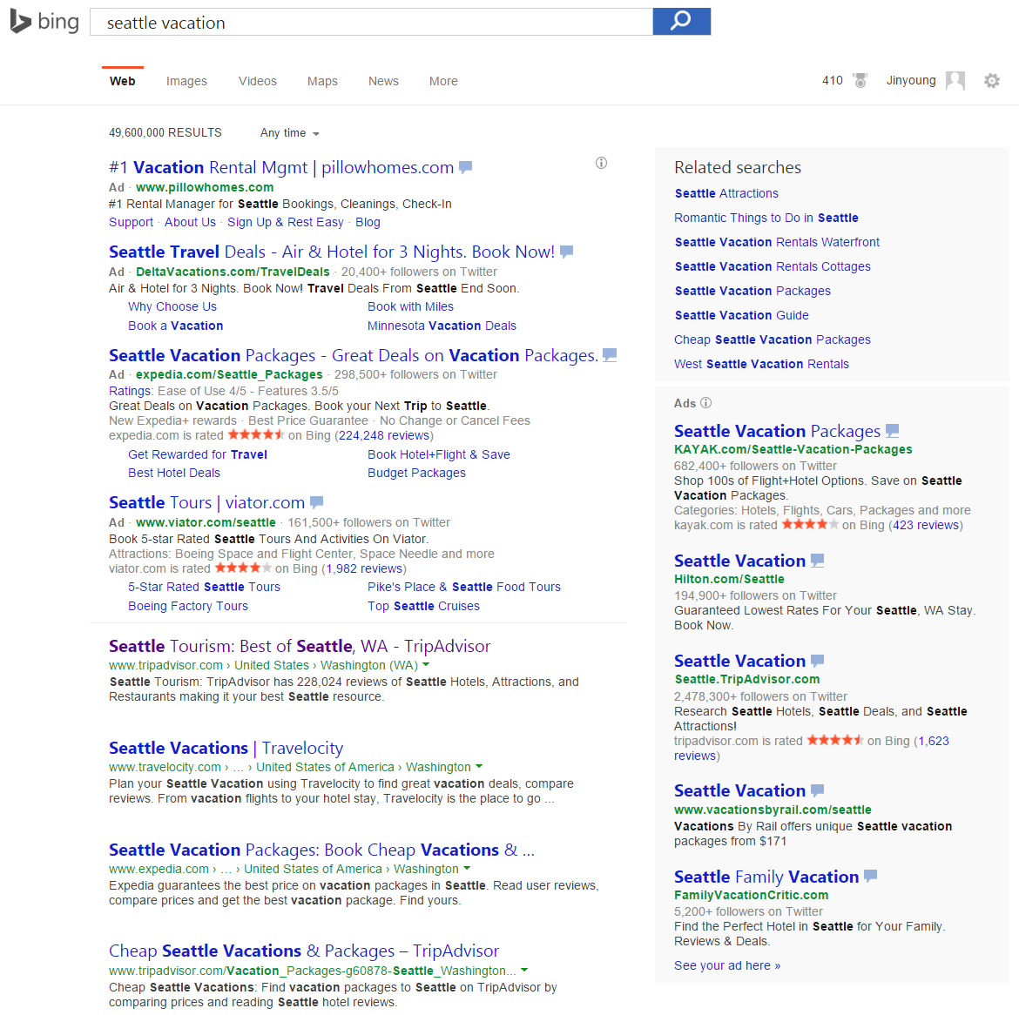
Agenda: Steps for Offline Evaluation
Preparing tasks
Designing a judging interface
Designing an experiment
Running the experiment
Evaluating the Experiment
Notes:
For the rest of this talk, I’ll follow the steps for …

Slide 9
Test Collection
Judgment
Metric
Test Collection
Judgments
Metrics
0.4
0.2
-0.3
-0.1
0
0.25

Slide 10
Preparing tasks

Slide 11
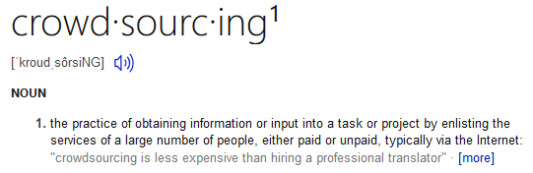

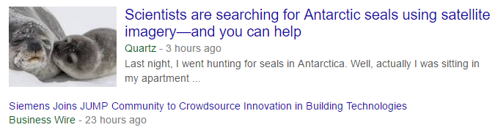

Search Tasks
What is crowdsourcing?
What’s the best resource to learn about crowdsourcing research?
Where can I find recent news on crowdsourcing?
Judging Target
Judging Criteria

Slide 12
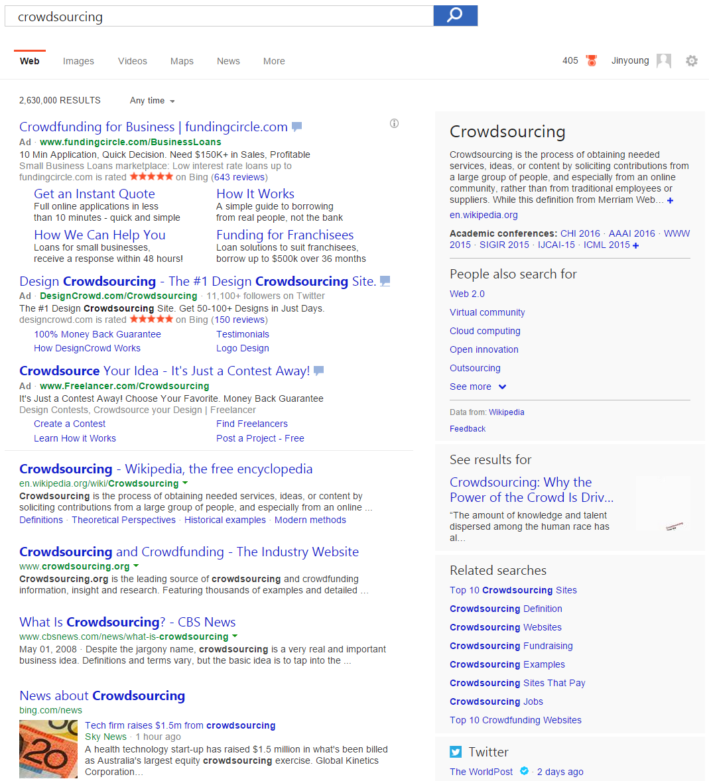
What constitutes a task?
Task
An information task from user
Task description
Some (expression of) information need
Search query / user profile / …
Target
System response to satisfy the need
SERP / webpage / answer / …

Slide 13
Sampling tasks (queries)
Random sample of user query is common method
What can go wrong in this approach?
Sampling criteria
Representative: Are the samples representative of the user traffic?
Actionable: Are they targeted for what we’re trying to improve on?
Need for more context
Are queries specific enough for consistent judgment?

Slide 14
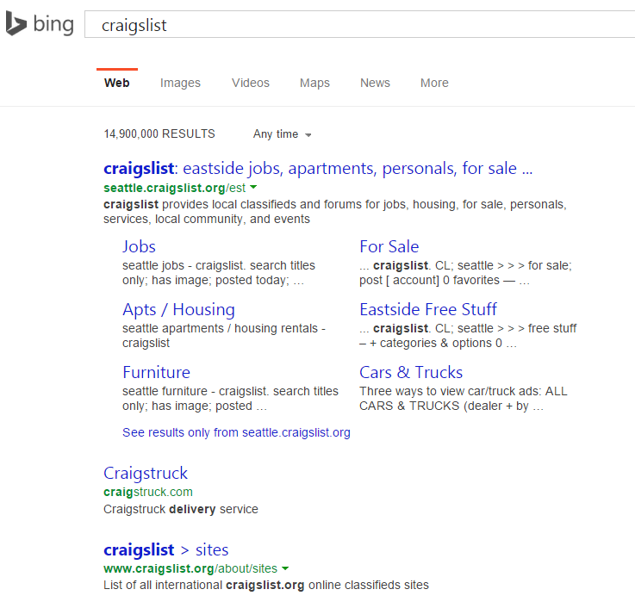
Add contexts if query alone is not enough
Context examples:
User’s location
Task description
Session history
…
Cost of contextual judging
Potentially need more judgments
Increase judge’s cognitive load
Notes:
Mention TREC topic desc.

Slide 15
Context Examples
User Location
Another document
Full session history

Slide 16
Designing a judging interface

Slide 17
How would you evaluate this result?

Slide 18
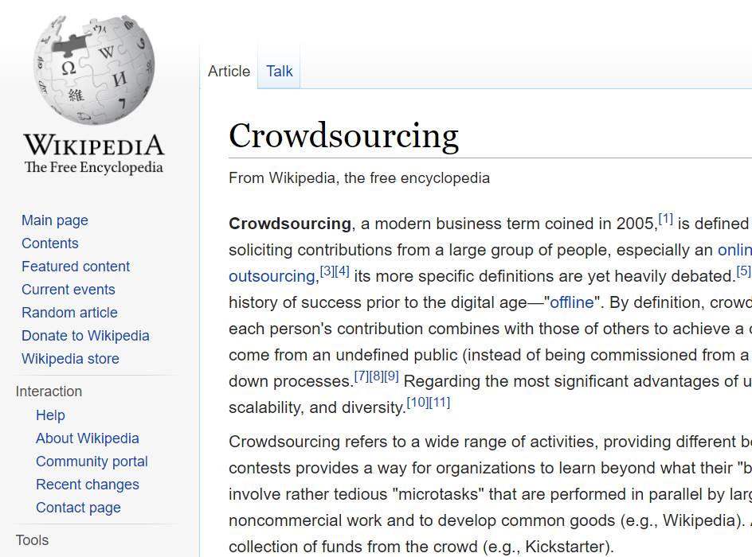
Determining Judging Target: Unit
Whole SERP
Webpage
SERP Elements

Slide 19
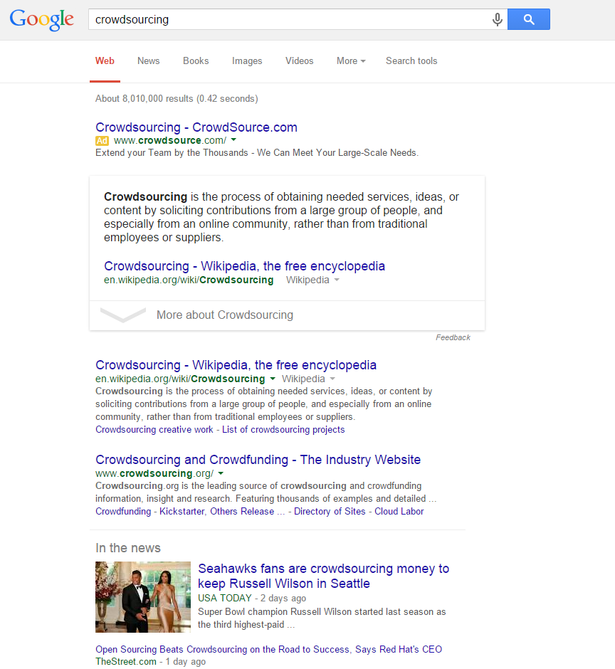
Absolute vs. Relative
Q: How would you rate the search results?
Not Relevant
Fair
Good
Excellent
Absolute
Q: How would you compare two sets of results?
Left much better
Left better
About the same
Right better
Right much better
Relative

Slide 20
Designing a judging interface: SERP*
Q: How would you rate the search results?
Not Relevant
Fair
Good
Excellent
Q: Why do you think so?
Questions
Responses
Judging Target
*SERP: Search Engine Results Page
Notes:
No ground for comparison / What if the judge doesn’t understand the intent?

Slide 21
Practice: Design your own Judging Interface
What can go wrong with the evaluation interface?
How can you improve the evaluation interface?

Slide 22

What can go wrong here?
Judges may like some part of the page, but not others
Judges may not understand the query at all
Each judge may understand the task differently
Rating can be very subjective without a clear baseline
…

Slide 23
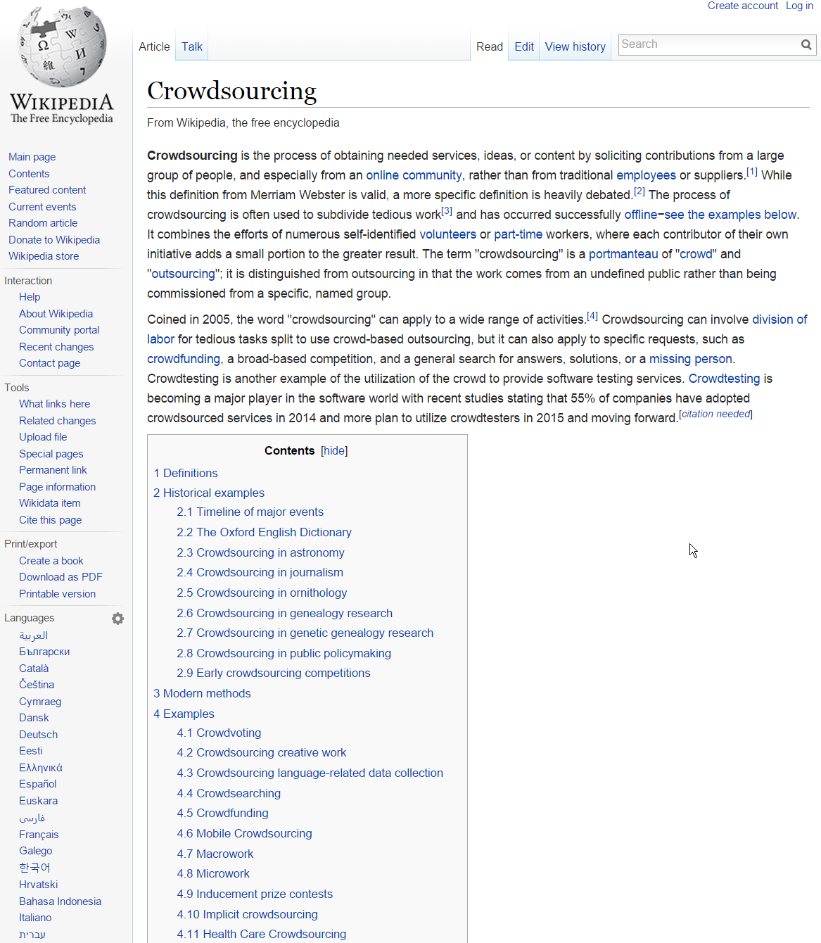
Designing a judging interface: web result
Given ‘crowdsourcing’ as a query, how would you rate the webpage?
Not Relevant
Fair
Good
Excellent
Q: Why do you think so?
Now the judging target is specific enough
Notes:
No ground for comparison / What if the judge doesn’t understand the intent?

Slide 24
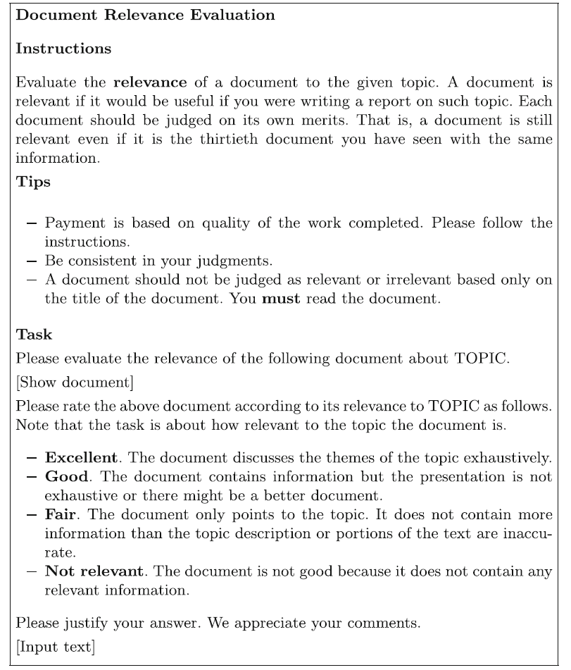
Judging Guideline
A document for judges to read before starting the task
Need to keep simple (i.e., one page), especially for crowd judges
Can’t rely on the guideline for all instructions: use training / tooltips

Slide 25
Designing a judging interface: Side-by-side
Q: How would you compare two results?
Left much better
Left better
About the same
Right better
Right much better
Q: Why do you think so?
The other page establishes a clear baseline for the judgment
Notes:
Should we use ‘about the same’ vs. ‘the same??

Slide 26
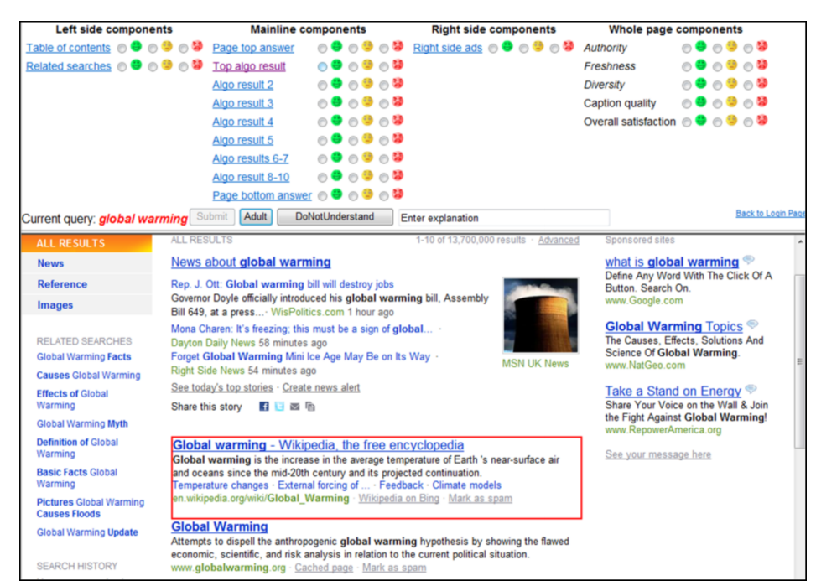
Evaluating Search Systems Using Result Page Context
Bailey et al. 2011 http://bit.ly/1QfuMji

Slide 27
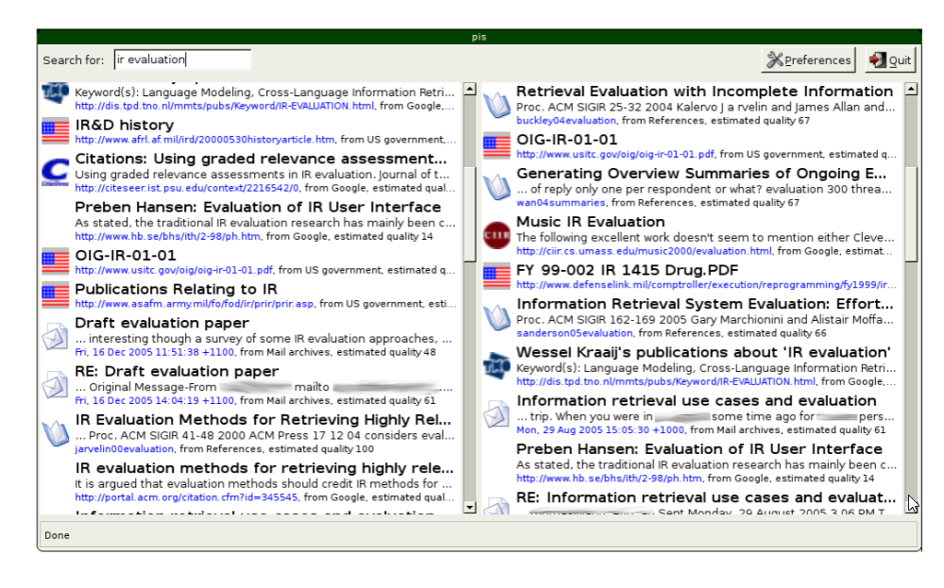
Evaluation by Comparing Result Sets in Context
[Thomas’06]

Slide 28
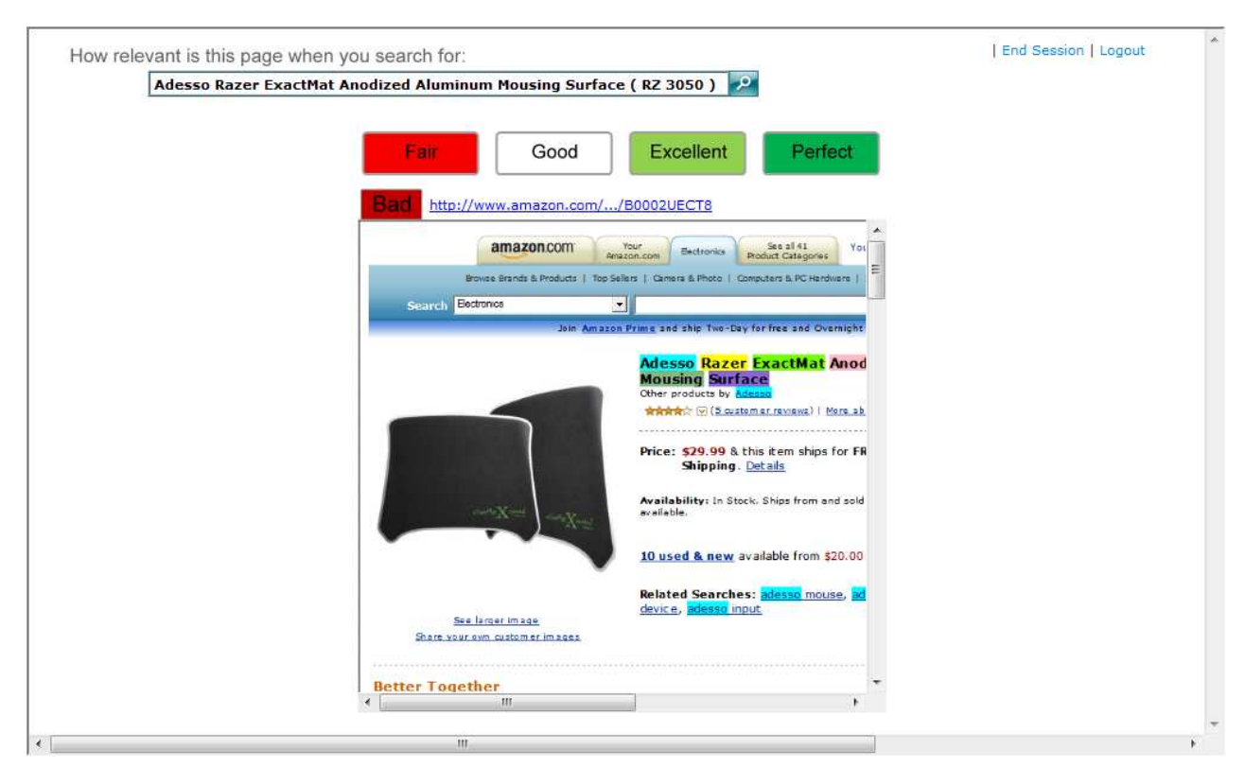
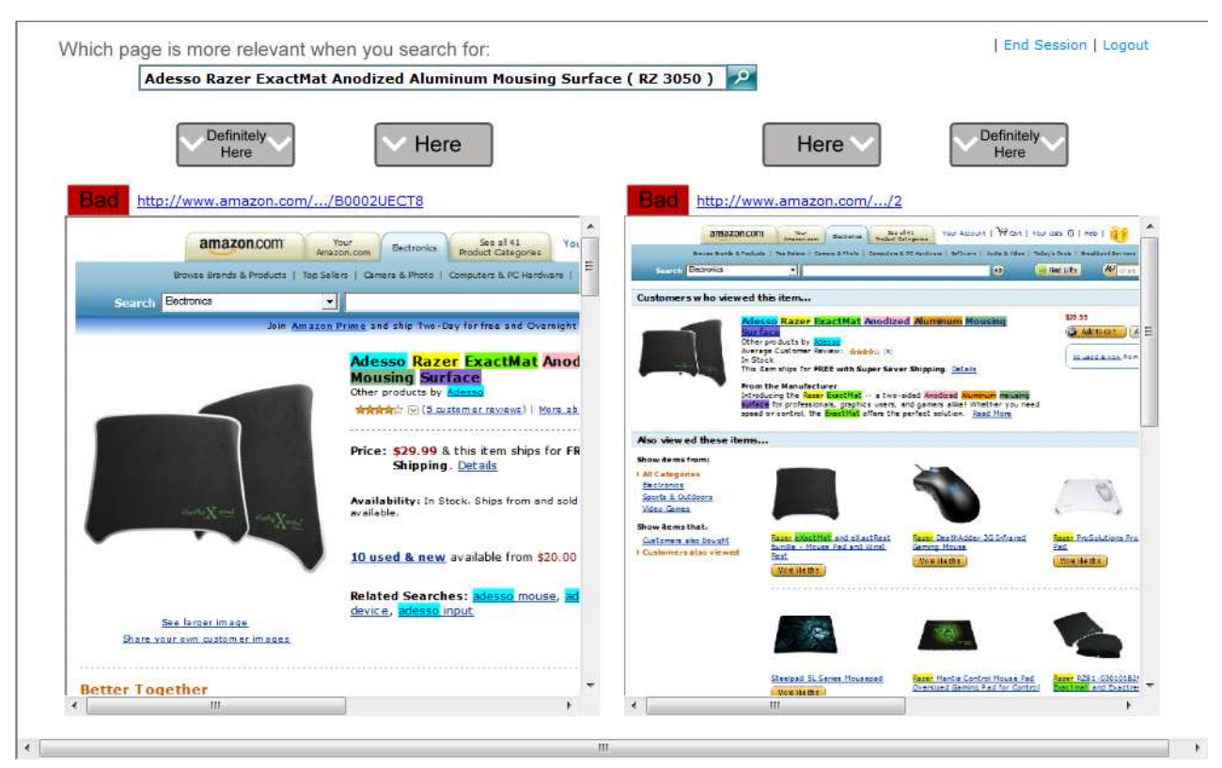
Here or There: Preference Judgments for Relevance _{[Carterette et al. 2008]}
Higher inter-judge agreement in preference judgement

Slide 29
Deciding on Judging Unit
What’s your measurement target?
Single feature
Whole experience
What’s your measurement goal?
Competitive analysis: relative
Training data collection: absolute
Shipping decision: both

Slide 30
Designing a judging interface
What to ask
Labels (of relevance, etc.)
Comments / Rationale
What’s the trade-off here?
Quantity vs. Quality vs. Cost
You can’t aim for everything!
How to make decisions?
Information-centric task
Number-centric task
Quantity / Info. Density
Cost / Judges’ Effort
Quality / Label Accuracy

Slide 31
Tips on judging interface design
Use plain language (i.e., avoid jargons)
Make the UI light and simple (e.g., no scroll)
Put ‘I don’t know’ (or skip) option (to avoid random responses)
Collect optional textual comments (for rationale or feedback)
Collect judging time and behavioral log data (for quality control)

Slide 32
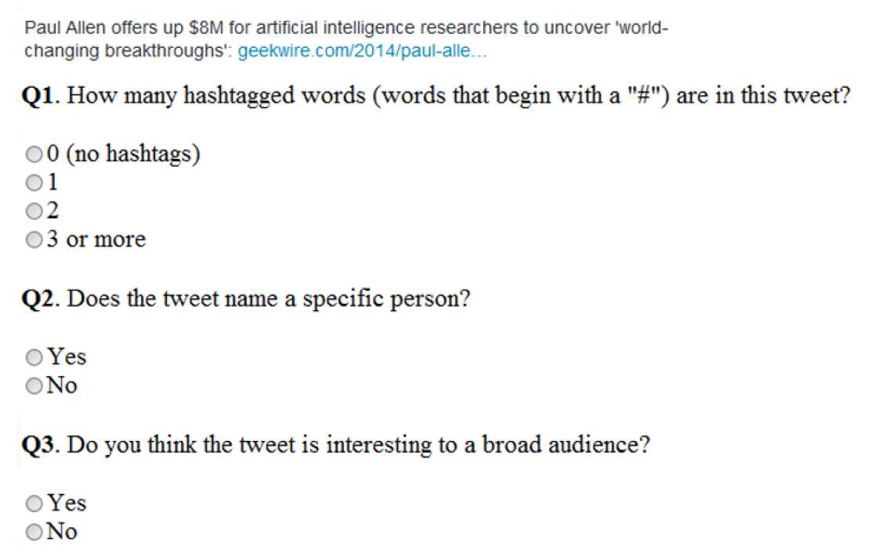
Using Hidden Tasks for Quality Control _{[Alonso ’15]}
Ask simple questions that require judges to read the contents
This prepare the judge for actual judging task
This provide ways to verify if the response is bogus

Slide 33
Designing an experiment
Notes:
One judgment is not enough!

Slide 34
From judgments to an experiment
Experiment
A set of judgments collected with a particular goal
A typical experiment consists of many tasks and judgments
Multiple judgments are collected for each task (overlap)
Types of goals
Resource planning: where to invest in next few months?
Feature debugging: what can go wrong with this feature?
Shipping decision: should we ship the feature to the production?
Judgments
Tasks
9 tasks X 3 overlap

Slide 35
Breakdown of Experimental Cost
How much money (time) spent per task?
How many (overlap) judgments per task?
How many tasks within experiment?
Judgments
10 | 10 | 10
10 | 10 | 10
10 | 10 | 10
10 | 10 | 10
10 | 10 | 10
10 | 10 | 10
10 | 10 | 10
10 | 10 | 10
10 | 10 | 10
Tasks
$ (time) per Judgment
# Judgments per Task
# Tasks within Experiment
10 cent = 30 second
(12$/HR)
3 judgments per task
9 tasks
Total cost: 2.7$
Notes:
Pay per task: how much of judges’ time do you want to borrow?

Slide 36
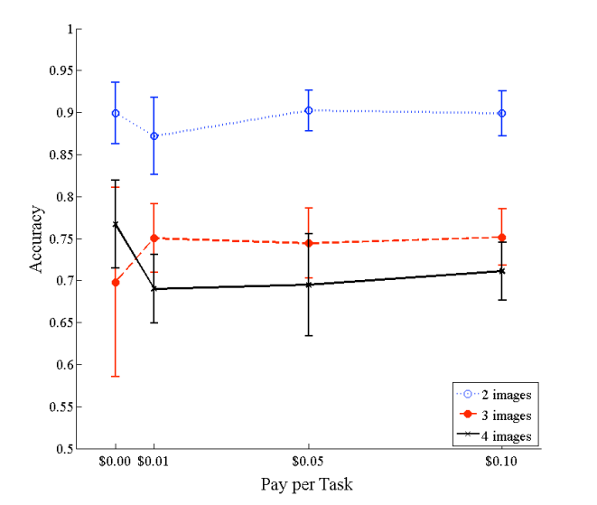
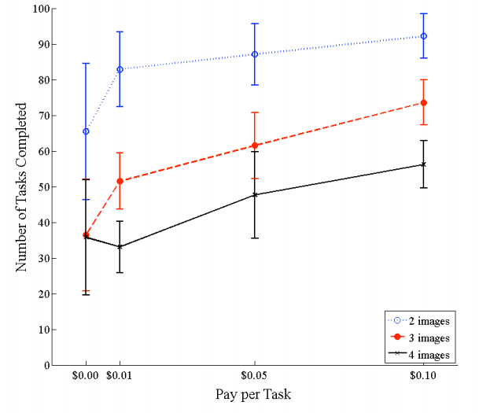
Effect of Pay per Task
[Mason and Watts, 2009]
Higher pay per task doesn’t improve judging quality, but throughput

Slide 37
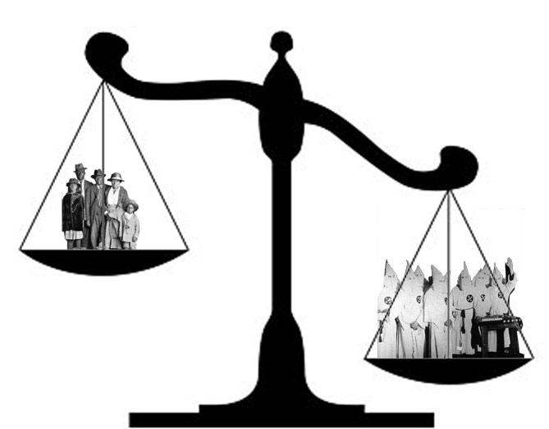
Why overlap judgments?
Better task understanding
What’s the distribution of labels?
What are judges’ collective feedback?
Quality control for labels / judges
What is the majority opinion for each task?
Who tends to disagree with the majority opinion?
Majority opinion is not always right, especially before you have enough of good judges

Slide 38
Majority Voting and Label Quality
[Kuncheva et al., PA&A, 2003]
Ask multiple labellers, keep majority label as “true” label
Quality is probability of being correct
p: probability
of individual labeller being correct

Slide 39
High vs. Low overlap experiment
High-overlap
Early iteration stage
Information-centric tasks
Low-overlap
Mature / production stage
Number-centric tasks
Judgments
Judgments
Tasks
Tasks
3 tasks X 9 overlap
9 tasks X 3 overlap
Notes:
Different layout?

Slide 40
Summary: Evaluation Goals & Guidelines
Evaluation Goal | Judgment Design | Experiment Design
Feature Planning / Debugging | Label + Comments | Information-centric (High overlap)
Training Data | Label + Comments | Specific to the algorithm
Shipping Decision (ExpA vs. ExpB) | Label + Comments | Number-centric (Low overlap)

Slide 41
Running the experiment

Slide 42
Choosing judge pools
Ground Truth Judgments
Development Team
In-house (managed) judges
Crowdsourcing judges
Ground Truth Judgments
Ground Truth Judgments
Less expertise
More judgments
Closer to users
Collect ground truth labels for next stage
Notes:
Dev team should definitely be the first judges

Slide 43

Choosing judge within the pool
Considerations
Do judges have necessary knowledge?
Do judge profiles match with target users?
Can they perform the task with reasonable accuracy?
Methods
Pre-screen judges by profile
Filter out judges by screening task
Kick off ‘bad’ judges regularly
Notes:
Screenshot?

Slide 44
Training judges: Training tasks
Given ‘crowdsourcing’ as a query, how would you rate the webpage?
Bad
Fair
Good
Excellent
Perfect
Q: Why do you think so?
Initial qualification task
Interleaved training task
Interleaved QA task
The Answer is ‘Excellent’
This document satisfies user’s main intent by providing well curated information about the topic
Notes:
Tasks with known answers are interleaved with regular tasks

Slide 45
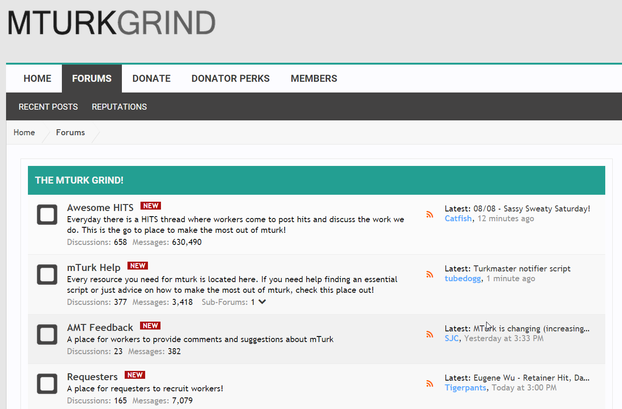
Crowd workers communicate with each other!
You need to manage your reputation as a requester.
(Quick payment / Responsive to workers’ feedback)
Answers shared with one worker is likely shared with all.

Slide 46
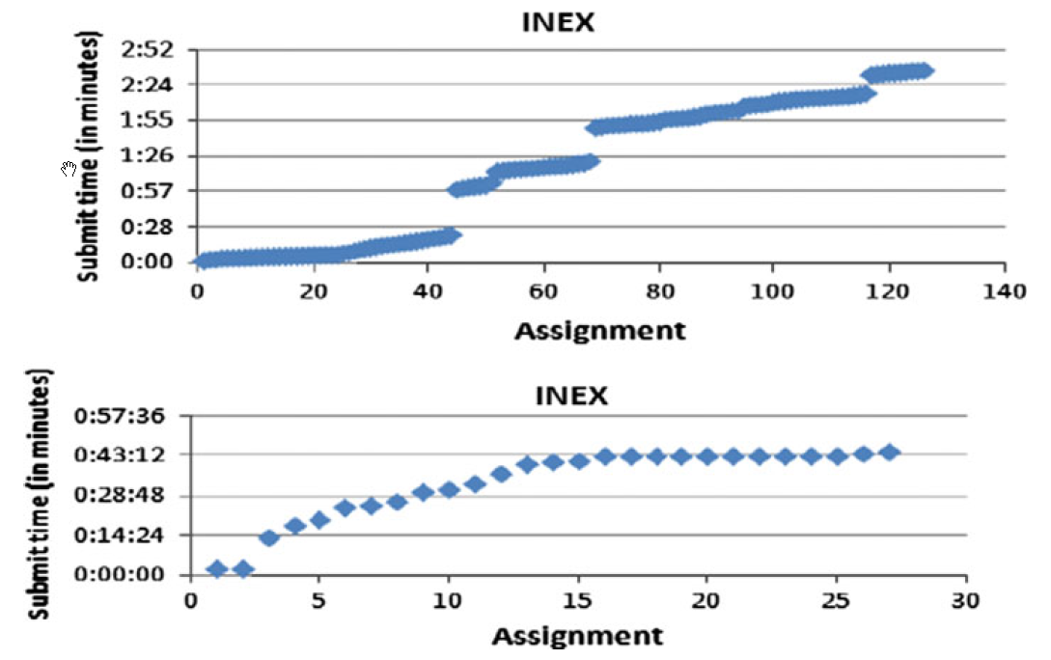
Cost of Qualification Test _{[Alonso’13]}
Judges become an order of magnitude slower under the presence of qualification tasks
However, depending on the type of task, the results may worth the delay and cost

Slide 47

Tips on running an experiment
Scale up judging tasks slowly
Beware of the quality of golden hits
Submit a big task in small batches (for task debugging / judge engagement)
Monitor & respond to judges’ feedback
Notes:
Judges need regular stream of jobs to stick to

Slide 48
Evaluating the Experiment

Slide 49
Analyzing the judgment quality
Agreement with ground truth (aka golden hits)
Inter-rater agreement
Behavioral signals (time, label distribution)
Agreement with other metrics

Slide 50
Comparing Inter-rater Metrics
Percentage agreement: the ratio the cases that received the same rating by two judges and divides the number by the total number of cases rated by the two judges.
Cohen’s kappa. estimate the degree of consensus between two judges by correcting if they are operating by chance alone.
Fleiss’ kappa: generalization of Cohen to n raters instead of just two.
Krippendorff’s alpha: accept any number of observers, being applicable to nominal, ordinal, interval, and ratio levels of measurement
https://en.wikipedia.org/wiki/Inter-rater_reliability

Slide 51
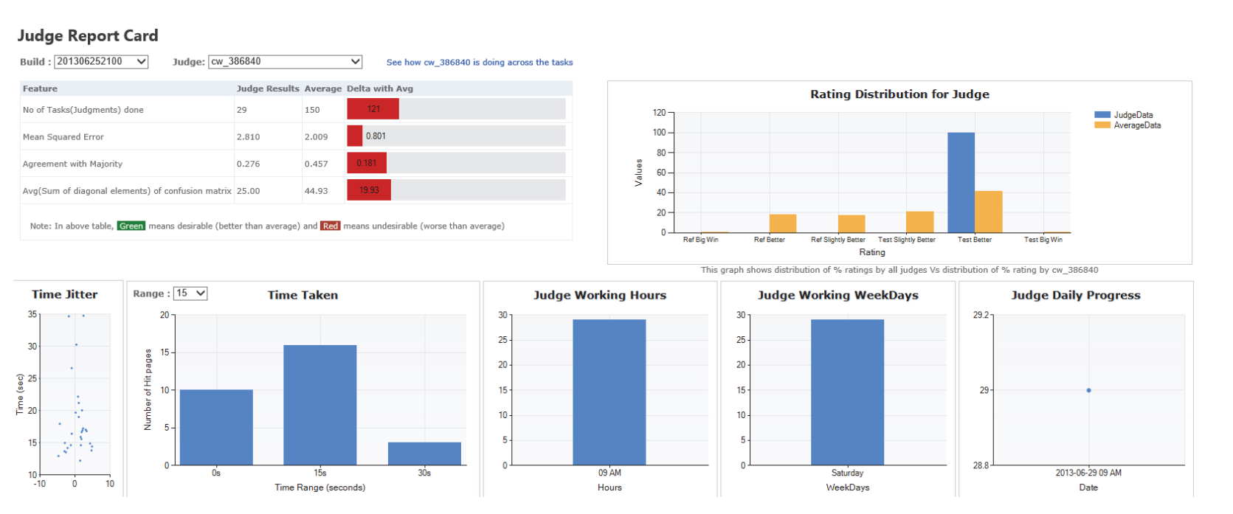
Analyzing the judgment quality
Automating Crowdsourcing Tasks in an Industrial Environment
Vasilis Kandylas, Omar Alonso, Shiroy Choksey, Kedar Rudre, Prashant Jaiswal

Slide 52
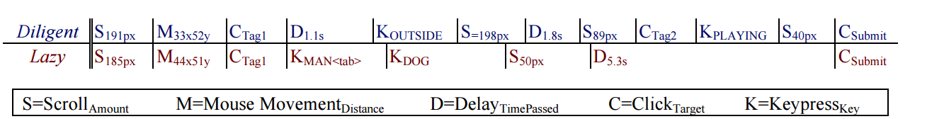
Using Behavior of Crowd Judges for QA
Predictive models of task performance can be built based on behavioral traces, and that these models generalize to related tasks.
Instrumenting the Crowd: Using Implicit Behavioral Measures to Predict Task Performance, UIST’11, Jeffrey M. Rzeszotarski, Aniket Kittur

Slide 53
Case Study: Relevance Dimensions in Preference-based IR Evaluation _{[Kim et al. ’13]}
Q: How would you compare two results?
Overall
Relevance
Diversity
Freshness
Authority
Caption
Q: Why do you think so?
Left Tie Right
Allow judges to break down their judgments along several dimensions

Slide 54
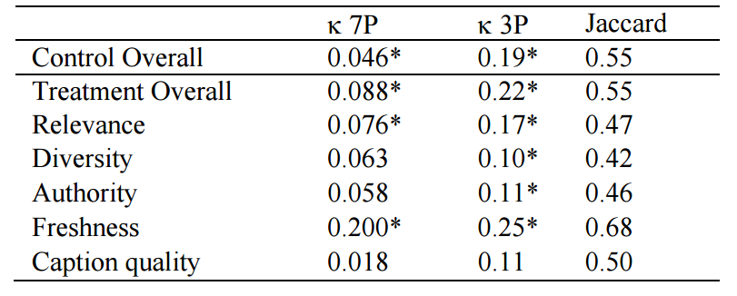
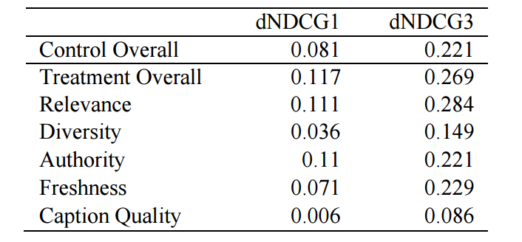
Case Study: Relevance Dimensions in Preference-based IR Evaluation _{[Kim et al. ’13]}
Inter-judge Agreement
Preference judgments vs. Delta in NDCG@{1,3} correlation
All achieved with 10% increase in judging time

Slide 55
Conclusions

Slide 56
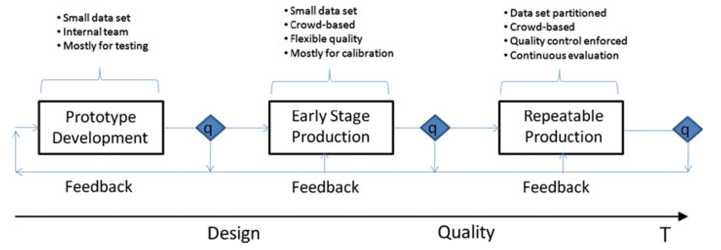
Building a Production Evaluation Pipeline
Omar Alonso, Implementing crowdsourcing-based relevance experimentation: an industrial perspective. Inf. Retr. 16(2): 101-120 (2013)

Slide 57
Recap: Steps for Offline Evaluation
Preparing tasks
Designing a judging interface
Designing an experiment
Running the experiment
Evaluating the Experiment
Notes:
For the rest of this talk, I’ll follow the steps for …

Slide 58
Main References
Implementing crowdsourcing-based relevance experimentation: an industrial perspective. Omar Alonso
Tutorial on Crowdsourcing Panos Ipeirotis
Amazon Mechanical Turk: Requester Best Practices Guide
Quantifying the User Experience. Sauro and Lewis. (book)

Slide 59
Optional

Slide 60
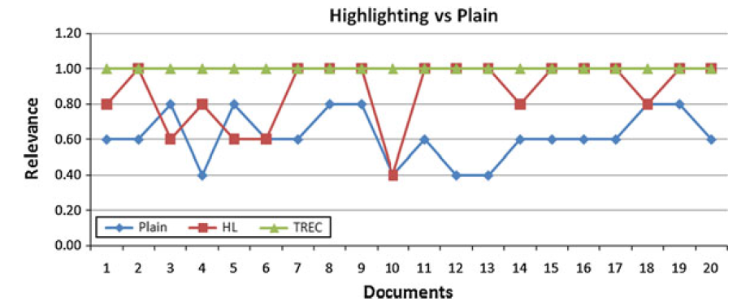
Impact of Highlights on Document Relevance
Highlighted versions of the document were perceived to be more relevant to plain versions. _{[Alonso, 2013]}
Subtle interface change can affect the outcome significantly
Notes:
Need to be careful if you want to change the judging interface suddenly…

Slide 61
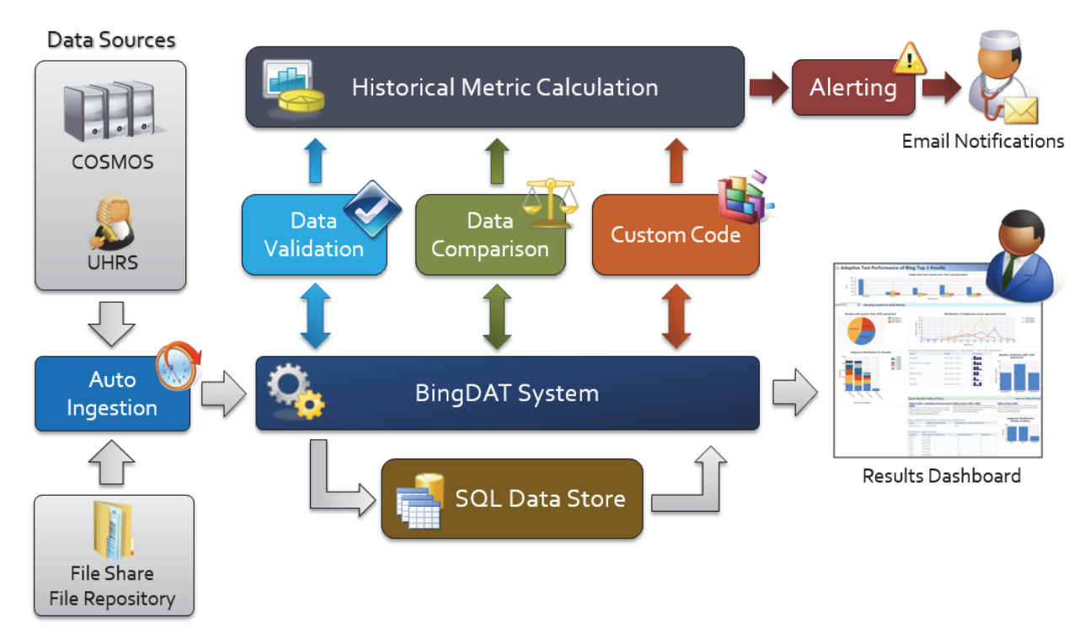
Architecture Example: BingDAT
Automating Crowdsourcing Tasks in an Industrial Environment
Vasilis Kandylas, Omar Alonso, Shiroy Choksey, Kedar Rudre, Prashant Jaiswal

Slide 62
Computing Cohen’s Kappa

Slide 63
Computing Quality Score: Cohen’s Kappa
Statistic used for measuring inter-rater agreement
Can be used to measure
Agreement with gold data
Agreement between two workers
More robust than error rate as it takes into account agreement by chance
Pr(a): Observed agreement among raters
Pr(e): Hypothetical probability of chance of agreement (agreement due to chance)

Slide 64
Computing Cohen’s Kappa
Computing probability of agreement (Pr(a))
Generate the contingency table
Compute number of cases of agreement/ total number of ratings
Worker 1
Total:
13
14
9
a b c
a
b
c
9 | 3 | 1
4 | 8 | 2
2 | 1 | 6
Worker 2
Total: 15 12 9 Overall total: 36

Slide 65
Computing Cohen’s Kappa
Computing probability of agreement (Pr(a))
Generate the contingency table
Compute number of cases of agreement/ total number of ratings
Worker 1
Total:
13
14
9
a b c
a
b
c
9 | 3 | 1
4 | 8 | 2
2 | 1 | 6
Pr(a) = (9+8+6)/36 = 23/36
Worker 2
Total: 15 12 9 Overall total: 36

Slide 66
Computing Cohen’s Kappa
Computing probability of agreement due to chance
Compute expected frequency for agreements that would occur due to chance
What is the probability that worker 1&worker 2 both label any item as an a?
What is the expected number of items labelled as a by both worker 1 and worker 2?
Worker 1
Total:
13
14
9
a b c
a
b
c
9 | 3 | 1
4 | 8 | 2
2 | 1 | 6
Pr(w1=a&w2=a) = (15/36)*(13/36)
E[w1=a&w2=a] = (15/36)*(13/36)*36
= 5.42
Worker 2
Total: 15 12 9 Overall total: 36

Slide 67
Computing Cohen’s Kappa
Computing probability of agreement due to chance
Compute expected frequency for agreements that would occur due to chance
What is the probability that worker 1&worker 2 both label any item as an a?
What is the expected number of items labelled as a by both worker 1 and worker 2?
Worker 1
Total:
13
14
9
a b c
a
b
c
9 (5.42) | 3 | 1
4 | 8 | 2
2 | 1 | 6
Pr(w1=a&w2=a) = (13/36)*(15/36)
E[w1=a&w2=a] = (13/36)*(15/36)*36
= 5.42
Worker 2
Total: 15 12 9 Overall total: 36

Slide 68
Computing Cohen’s Kappa
Computing probability of agreement due to chance
Compute expected frequency for agreements that would occur due to chance
What is the probability that worker 1&worker 2 both label any item as an a?
What is the expected number of items labelled as a by both worker 1 and worker 2?
Worker 1
Total:
13
14
9
a b c
a
b
c
9 (5.42) | 3 | 1
4 | 8 (4.67) | 2
2 | 1 | 6 (2.25)
Pr(w1=a&w2=a) = (13/36)*(15/36)
E[w1=a&w2=a] = (13/36)*(15/36)*36
= 5.42
Worker 2
Total: 15 12 9 Overall total: 36

Slide 69
Computing Cohen’s Kappa
Computing probability of agreement due to chance
Compute expected frequency for agreements that would occur due to chance
What is the probability that worker 1&worker 2 both label any item as an a?
What is the expected number of items labelled as a by both worker 1 and worker 2?
Worker 1
Total:
13
14
9
a b c
a
b
c
9 (5.42) | 3 | 1
4 | 8 (4.67) | 2
2 | 1 | 6 (2.25)
Pr(e) = (5.42+4.67+2.25)/36
Worker 2
Total: 15 12 9 Overall total: 36

Slide 70
Computing Cohen’s Kappa
Computing probability of agreement due to chance
Compute expected frequency for agreements that would occur due to chance
What is the probability that worker 1&worker 2 both label any item as an a?
What is the expected number of items labelled as a by both worker 1 and worker 2?
Worker 1
Total:
13
14
9
a b c
a
b
c
9 (5.42) | 3 | 1
4 | 8 (4.67) | 2
2 | 1 | 6 (2.25)
Pr(e) = 12.34/36
Pr(a) = 23/36
Kappa = (23-12.34)/(36-12.34) = 0.45
Worker 2
Total: 15 12 9 Overall total: 36

Slide 71
What is a good value for Kappa?
Kappa >= 0.70 => reliable inter-rater agreement
For the above example, inter-rater reliability is not satisfactory
If Kappa<0.70, need ways to improve worker quality
Better incentives
Better interface for the task
Better guidelines/clarifications for the task
Training before the task…

Slide 72
Calculating the Confidence Interval

Slide 73
Drawing Conclusions
Hypothesis testing (covered in Part I)
How confident can we be about our conclusion?
Confidence interval
How big is the improvement?
How precise is our estimate?
Both statistical significance and confidence interval should be reported!
Notes:
These can be derived from the sampling distribution

Slide 74
Confidence Interval and Hypothesis Testing
Confidence Interval
Does the 95% C.I. of sample mean include zero?
Hypothesis Testing
Does 95% C.I. under H0 include the critical value ?
0
Sample Mean
95% Confidence Interval
0
Critical Value
95% Conf. Int. under H0

Slide 75
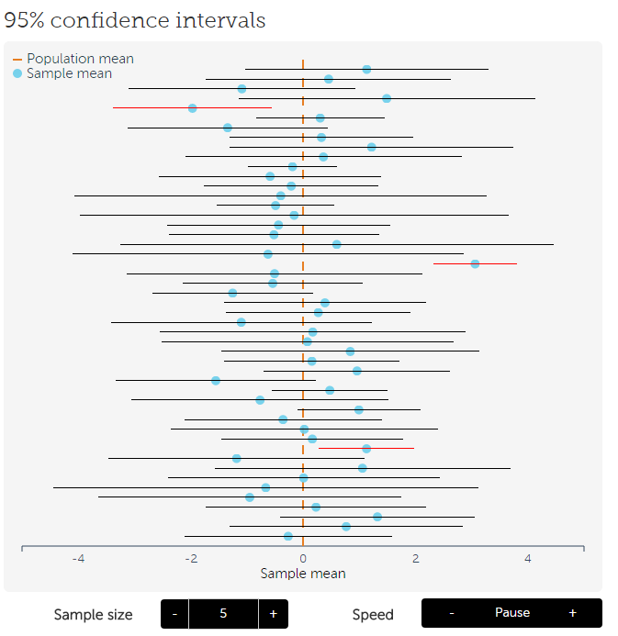
Sampling Distribution and Confidence Interval
95% confidence interval: 95% of sample means will fall under this interval
This means 95% of sample will include the mean of original sample
http://rpsychologist.com/d3/CI/
Notes:
, which is our best guess for the population mean

Slide 76
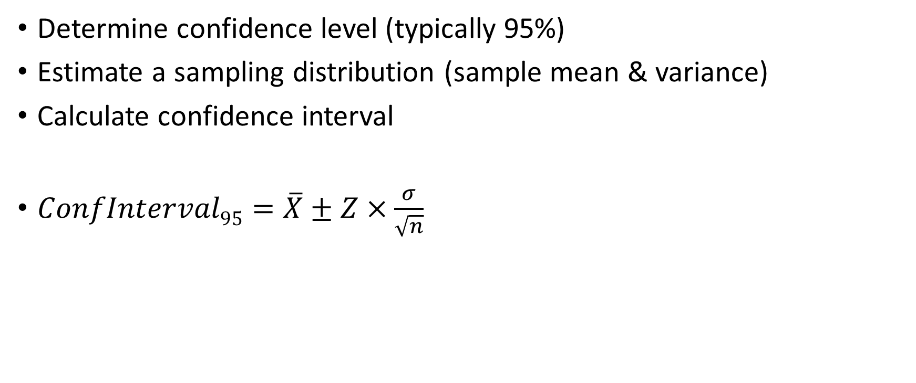
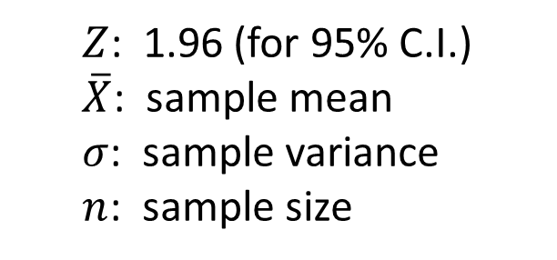
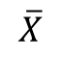
Computing the Confidence Interval
Determine confidence level (typically 95%)
Estimate a sampling distribution (sample mean & variance)
Calculate confidence interval
$ConfInterval95=\overline{X}±Z×\frac{σ}{\sqrt{n}}$
Sampling Distribution
$Z$: 1.96 (for 95% C.I.)
$\overline{X}$: sample mean
$σ$: sample variance
$n$: sample size
$$\overline{X}$$
95% Confidence Interval
Notes:
If you flip this, you can have hypothesis testing

